Slide 1
Week 04

Slide 2
You made it to Week 4!
$ telnet towel.blinkenlights.nl
IS GONE?!
$ curl parrot.live

Slide 3
Updates
Lab 02 - Submit for late penalty until 9/16
Lab 03 - Live, Due 9/20
https://github.com/pattonsgirl/Fall2021-CEG2350/blob/main/Quizzes/Quiz1.md
Quiz 2 - 9/23

Slide 4
Finishing a demo
We played with the power of the root user
It’s real power is it can change the permission of any file to be something it can edit

Slide 5
Commands so far
man
ls
cat
vim
history
cd
pwd
touch
mkdir
rmdir
cp
mv
chmod
chown
chgrp
sudo
git clone
git add
git commit
git push
* vs . vs ..

Slide 6
Two Paths Diverge…
Talking about path and path

Slide 7
Absolute vs Relative Path
Relative is relative to where you are
Can still be a path, though
class-examples/my_file.txt
file_open(my_file);
../mydir/text.txt
Absolute is the full directory path, no shortcuts
/home/ubuntu/class-examples/my_file.txt
file_open(C:\Users\kduncan\Documents\data\my_file.txt)

Slide 8
Environment Variables: PATH
How does the OS know where to find things?
Windows
System Properties -> Advanced tab -> Environment Variables
Linux
$ env # shows all environment variables
$ printenv PATH
echo $PATH
Notes:
https://www.cyberciti.biz/faq/linux-list-all-environment-variables-env-command/

Slide 9
PATH: What is it?
List of folders that hold executables
The executables can be
binaries (Linux is written in C)
cmdlets for Powershell
Scripts
We can specify the interpreter in a script
We can say: run with bash, python, or other interpreted languages

Slide 10
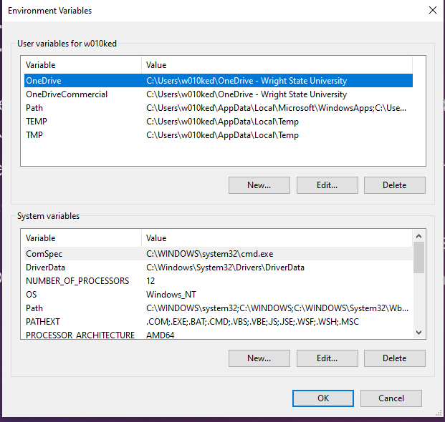
Windows – System vs User Environment Variables
Some installers prompt to install for “you” or “any user on your system / all users”
System variables exist for anyone who goes on the system
Account agnostic
User environment variables exist just for your user
Other users cannot use your user’s Path environment variables

Slide 11
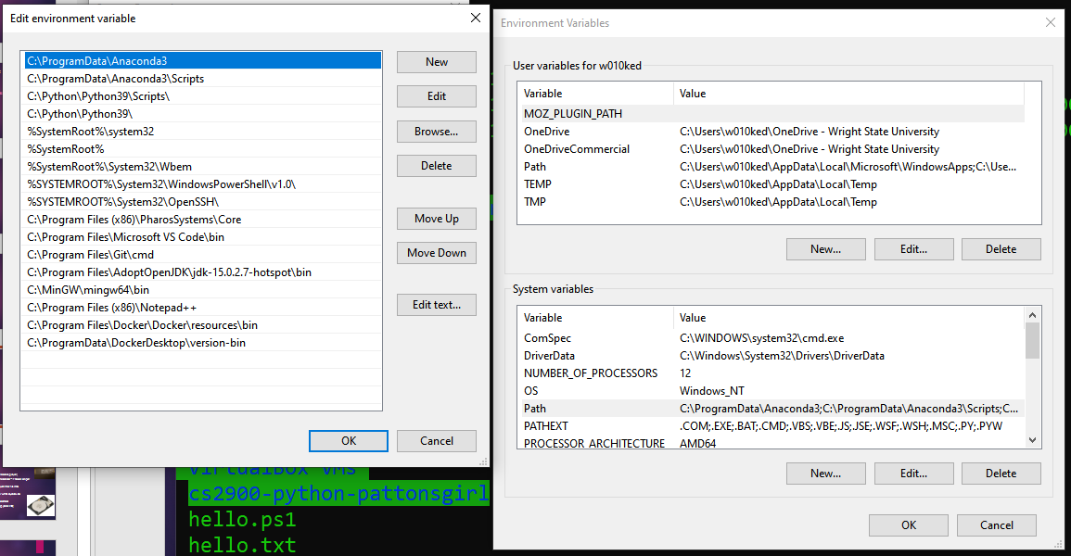
PATH

Slide 12
Hunting Down a Program
Useful for seeing which version of a command you are running
Ex. python versions, accidental override of command, compiler locations (in case you need to change defaults)
Windows (cmd.exe & Powershell):
where.exe program_or_command
Linux:
which program_or_command
whereis program_or_command
Notes:
https://benohead.com/blog/2013/04/16/linux-which-vs-whereis

Slide 13
Example: python3
Debian Linux:
$ sudo apt install python3
apt is a package manager - holder of software that has been verified via official channels
Verify / update path
Verify working in shell
Windows:
https://www.python.org/downloads/
Install for all or just me?
Verify / update PATH
Verify working in cmd or Powershell

Slide 14
All about that base (knowledge)
Aliases, base concepts, intro to bash scripting, intro to regex

Slide 15
Terminals
Terminal emulator
This is a program that opens a window and lets you interact with the shell.
gnome-terminal, konsole, xterm, rxvt, kvt, nxterm, and eterm
WSL2 is a terminal emulator, using a bash shell
CMD is a shell
Originally built for MS-DOS
Powershell is a shell
Windows 7 onward
Notes:
https://www.varonis.com/blog/powershell-vs-cmd/
https://study.com/academy/lesson/ssh-bash-scripts.html

Slide 16
Shells
A shell is a command line interface (CLI)
shell is a program that takes commands from the keyboard and gives them to the operating system to perform
Linux systems usually use bash
Bourne Again Shell
an enhanced version of the original Unix shell program, sh, written by Steve Bourne
other shell programs available for Linux systems include: ksh, tcsh and zsh
Notes:
https://linuxcommand.org/lc3_lts0010.php
https://www.cyberciti.biz/tips/how-do-i-find-out-what-shell-im-using.html

Slide 17
Remote Connections
Secure Shell (SSH)
cryptographic network protocol for operating network services securely over an unsecured network.
Typical applications include remote command-line, login, and remote command execution, but any network service can be secured with SSH.
Think secure communication between shells
Remote Desktop Protocol (RDP)
proprietary protocol developed by Microsoft which provides a user with a graphical interface to connect to another computer over a network connection.
The user employs RDP client software for this purpose, while the other computer must run RDP server software
Notes:
https://en.wikipedia.org/wiki/Secure_Shell
https://en.wikipedia.org/wiki/Remote_Desktop_Protocol

Slide 18
Alias
Aliasing is handy for long commands that have repetitive use or a command with flags that you frequently use and are tired of typing
Try `alias` - some terminal colors exist
To temporarily set:
alias list='ls –lah’
Will not work after terminal closes, or use can use `unalias`

Slide 19
Permanently Set an Alias
To permanently set:
WSL2 / Linux / Mac: add to your .bashrc file
Moba + CygUtils: add to your .bash_profile file
source .bashrc

Slide 20
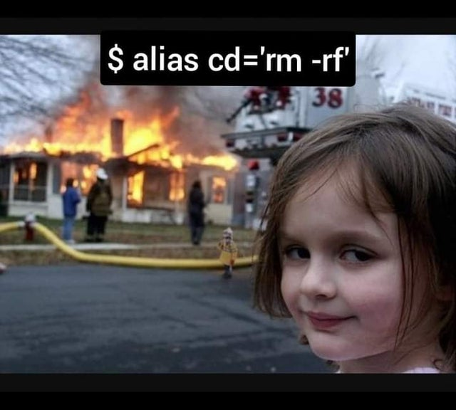
Be Careful!

Slide 21
~/.profile vs ~/.bashrc
.bashrc – specific to bash
Aliases, colorings, things specific to the bash shell
.profile – stuff that applies to your whole session
Programs that you want to start when you log in
Environment variable definitions
Notes:
https://superuser.com/questions/183870/difference-between-bashrc-and-bash-profile/183980#183980

Slide 22
Food for Thought: Powershell
How do some commands, cd, ls, etc run in Powershell?
> alias
List of all commands that are aliased to their real Powershell cmdlets
Think of a cmdlet as a binaries - compiled, all in one, unchanging

Slide 23
Input / Output Redirection
Command > filename
Overwrites the file
Command >> filename
Appends to the file
Command < filename
Reads in from file
Command < input_filename > output_filename
Notes:
https://tldp.org/LDP/abs/html/io-redirection.html
https://tldp.org/HOWTO/Bash-Prog-Intro-HOWTO-3.html

Slide 24
Pick up here
Present revision…
https://www.cyberciti.biz/open-source/command-line-hacks/matrix-digital-rain-on-linux-macos-unix-terminal/
$ sudo apt install cmatrix
$ cmatrix
We and the support team have said a tearful farewell to blinkenlights.
https://www.youtube.com/watch?v=EJAbbRh9q4k&ab_channel=YellowPurple

Slide 25
Output:
$ echo
Puts a newline at end of output
$ printf
Requires newline be formatted (that \n you are familiar with)

Slide 26
Standard Streams
Standard input (0)
Think of typing on keyboard
Cat redirects input to output
Standard output (1)
Stuff showing up on the screen
Checkout echo command
Standard error (2)
Bad commands / bad command input
Ex. ls %, misspelled command, etc.

Slide 27
Error Redirection
Mostly used for log files
Command 2> filename
Errors directed to file
Command 2>> filename
Appends errors to file

Slide 28
Some Examples
$ echo “all this text” > newfile
$ cat < filename
Cat actually prints line by line. Cat can concatenate files together
$ cd unrealfolder 2> errors
$ cat
Hit enter, and it’s waiting… type some stuff! Now leave…
Now run the command and save your stuff
Ctrl+D exits to save. Ctrl+C just exists
https://www.guru99.com/linux-redirection.html
Notes:
https://www.guru99.com/linux-redirection.html
https://www.geeksforgeeks.org/input-output-redirection-in-linux/
https://linuxcommand.org/lc3_lts0070.php
https://tldp.org/LDP/abs/html/io-redirection.html

Slide 29
Piping
Command1 | Command2
Passes the output of one command to the input of another command
Silly example: fortune | cowsay
Note: may need to install fortune & cowsay
Seriously useful: history | grep ssh
Examples:
$ cat filename | less
$ sort filename | uniq
You can keep chaining piped output
Notes:
https://www.geeksforgeeks.org/piping-in-unix-or-linux/
https://www.guru99.com/linux-pipe-grep.html

Slide 30
Grep – new trick
'grep' - allows you to search for a certain pattern
It is super versatile
You could find a phrase or pattern (looking at you, regular expressions), in a file or a series of files
Pipe output of a command to grep followed by a search term to narrow results
$ history | grep “what I’m looking for”
Search your past to help your future!

Slide 31
Tee, Less, and More
Tee outputs to terminal & to the file you want to store output
The tee program reads standard input and copies it to both standard output (allowing the data to continue down the pipeline) and to one or more files
$ df -h | tee disk_usage.txt
$ ls /usr/bin | tee ls.txt | grep zip
Capture the entire directory listing to the file ls.txt before grep filters the pipeline’s contents
Piping to 'less' & 'more'
'less' lets you gently scroll through output (like it was a file)
'more' lets you scroll through in large steps (like it was a file)
Notes:
https://linuxize.com/post/linux-tee-command/

Slide 32
Intro to Scripting
Bash only here

Slide 33
What is a script?
A script is a program
Bash, python, cmd.exe, powershell – all scripting languages
Known as interpreted language
No compiling
No separate executable to run the program
Notes:
https://ryanstutorials.net/bash-scripting-tutorial/bash-script.php

Slide 34
Ways to create & run a script
Put commands in a file.
Run “source just_commands.sh” OR “. just_commands.sh”
There is a space between . and the rest
At top of file, put “#! /bin/bash”
Make file executable – use those permissions!
Run “./just_commands.sh”
Notes:
https://tldp.org/LDP/Bash-Beginners-Guide/html/sect_07_01.html

Slide 35
Variables
Avoiding using an existing environment variable name
Check env or printenv for current environment variables
VARIABLE_NAME=VALUE
$VARIABLE_NAME to use in script after declaring
All caps variables are usually global / environment variables
$ sayhi=“Hello there friend!”
A variable is not an alias
Print statements work with variables
Notes:
https://tldp.org/HOWTO/Bash-Prog-Intro-HOWTO-5.html

Slide 36
Arguments
my_script.sh hello.txt world.txt
Reference hello.txt as $1, world.txt as $2, and so on
Reference script name with $0
$ cd foldername
foldername is an argument
How many arguments: $#
List of all arguments: $@
Notes:
https://www.baeldung.com/linux/use-command-line-arguments-in-bash-script

Slide 37
Conditionals!
The if statement uses [ ] - in between those go the test you want
$ man [
test enters the room!
The square bracket is bound to the test command. Any condition available with the test command is a condition you can utilize
We are going to use [[ for conditions
Think of this as test 2.0 - it has some cooler tools we can use
Include pattern matching with regular expressions!
Notes:
https://unix.stackexchange.com/questions/306111/what-is-the-difference-between-the-bash-operators-vs-vs-vs

Slide 38
Conditional Statements (If)
if [[ condition ]]; then
Stuff_to_do
fi
if [[ condition ]]; then
Stuff_to_do
else
Other_stuff_to_do
fi
Notes:
http://www.compciv.org/topics/bash/conditional-branching/
https://tldp.org/LDP/Bash-Beginners-Guide/html/sect_07_01.html

Slide 39
Conditional Statements (If)
if [[ condition ]]; then
Stuff_to_do
elif [[ condition ]]; then
Stuff_to_do
else
Other_stuff_to_do
fi
Notes:
http://www.compciv.org/topics/bash/conditional-branching/

Slide 40
Exercise
Script that checks if file exists
Prints file content if it exists.
Else creates the file
Put #! /bin/bash at top of file (it will be a bash program)
Check script is runnable – chmod
Run with ./script_name

Slide 41
What are regular expressions?
The idea of using a “code” to match a pattern in text
Commonly used with `sed` or `grep`
Think of regex as writing a pattern match for a given array

Slide 42
Class plays regex
https://regexone.com/lesson/introduction_abcs
Walking through usage lessons 1-10
Fun testing site:
https://regex101.com/
Regex cheatsheet:
https://cheatography.com/davechild/cheat-sheets/regular-expressions/

Slide 43
RegEx in a Script
For a condition (such as in an if statement)
[[ STRING =~ REGEX ]]

Slide 44
Exercise
Script that checks if file ends in .md
Prints contents if it does.
Else prints “File does not have correct extension”

Slide 45
In class script
https://github.com/pattonsgirl/Fall2021-CEG2350/blob/main/Labs/Lab03/in-class-script

